Slide 1
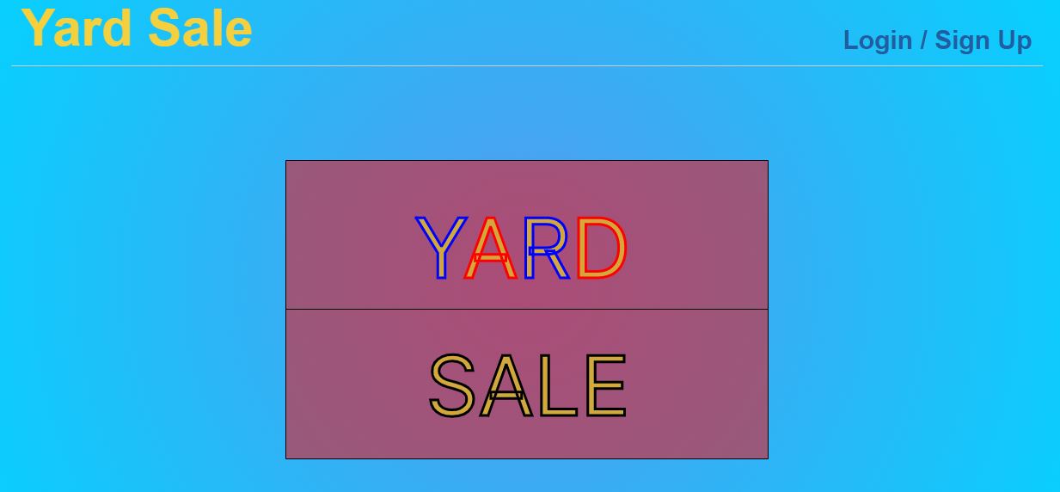

Slide 2
Overview
For those interested in saving money and saving the environment, Yard Sale offers users the ability to buy and sell gently-used pre-loved items with people from their neighbourhood.

Slide 3
The reason we built Yard Sale
Motivation for development
Life is expensive - yard sale enables people to post for sale items they no longer use, and buy items they need at a lower cost than retail or Amazon
Help save the environment - buying and selling used items places less of a burden on our planet’s precious resources
User Story
As an environmentally conscious individual living on a budget I want to be able to buy and sell gently-used pre-loved items with people in my neighbourhood

Slide 4
Process
Technologies used
NODE.JS
EXPRESS.JS
MYSQL
Sequelize ORM
Vivus
DotEnv
Express-session
Express-Handlebars
Bootstrap
Heroku
Tasks & Roles
Reena - Models, Routes, Handlebar view, front-end javascript, CSS
Neet - Vivus, Authentication, Heroku, protecting sensitive information, README
Alex - Handlebar view, front-end javascript, CSS

Slide 5
Ideas for future development
Add categories
Add new versus old tag
Enable users to ask questions about items through a comment box
Enable users to update their post with new information or make corrections
Enable sellers to mark their items as ‘sold!’
Create a dashboard page where users can view the items they have placed for sale

Slide 6
Working as a team
Challenges
Tight timeline and busy schedules
Communication - who is doing what?
Deciding on the additional Node.js module
GitHub - managing and merging various branches
Successes
Efficient meetings
Collaborative effort
Learning new technologies
Learning from and supporting each other

Slide 7
Check Out
Yard Sale!
Heroku - https://yard-5ale.herokuapp.com/
GitHub - https://github.com/RHunjan/yard-sale

